Slide 1
SAMPLES: Self Adaptive Mining of Persistent LExical Snippets for Classifying Mobile Application Traffic
Gyan Ranjan
Principal Data Scientist,
Symantec Corporation, USA.

Slide 2
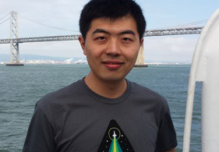



Partenaires dans le Crime
Hongyi Yao
University of Michigan,
Anne Arbor, MI, USA.
hyyao@umich.edu
Alok Tongaonkar
Symantec Corporation,
Mountain View, CA, USA.
alok_tongaonkar@symantec.com
Yong Liao
Symantec Corporation,
Mountain View, CA, USA.
yong_liao@symantec.com
Z. Morley Mao
University of Michigan,
Anne Arbor, MI, USA.
zmao@umich.edu

Slide 3
1 | Motivation & Background
2 | Identifiers, Lexical Snippets & Conjunctive Rules
3 | Methodology
4 | Evaluation

Slide 4
1 | Motivation & Background
2 | Identifiers, Lexical Snippets & Conjunctive Rules
3 | Methodology
4 | Evaluation

Slide 5
Why Bother?
Network operators require clear and detailed visibility into their traffic
  Network measurement tasks
    Application behavior profiles, usage statistics …
  Network management tasks
    Bandwidth provisioning, application level firewalls, access control …
The mobile era
  Multiple platforms, millions of applications
    Android, iOS, Nokia/Symbian, BlackBerry, Windows Mobile.
  Bring-Your-Own-Device (BYOD) to work
    Practically no control on devices.

Slide 6
Ideally, One would Like to…
Identify the mobile application responsible for a given flow
  Observed at a network vantage point
  Without access to the end-user’s device
The bad news is
  HTTP/HTTPS preferred protocol for communication
    Protocol/volumetric based solutions are rendered useless.
The GOOD news is
  HTTP/HTTPS preferred protocol for communication
    Standard format: Header fields + Payload.
    Content: Plain text with application identifiers.

Slide 7
And the World’s been Listening … Well, Partially!
Identifying diverse usage behaviors of smartphone apps [IMC 2011].
  Identification based on User-Agent fields.
Understanding mobile app usage patterns using in-app advertisements [PAM 2013].
  Identification based on key-value pairs assigned by advertisement networks.
Networkprofiler: Towards automatic fingerprinting of android apps [Infocom, 2013].
  Identification based on exhaustive state-machine creation for each application.
Automatic generation of mobile app signatures from traffic observations [Infocom,2015].
  Identification based on signatures extracted from flow-groups.
Ad hoc, require manual inspection & expertise, or computationally too complex to be of practical use.

Slide 8
Let there be SAMPLES …
Self Adaptive Mining of Persistent Lexical Snippets
  Light weight crawl-download-execute infrastructure to create training and test traffic.
  Self adaptively trains a rule generator using a small fraction of apps (less than 2% for each platform).
  Performs aggregation and validation of rules to produce a rule set (fewer than 100 in all).
  Helps identify hundreds of thousands of apps using an extract and validate paradigm.
  Achieves high goodput which bodes well for a real world deployment.
In summary, there’s One RULE to Rule them All: SAMPLES. Well, not quite, but you get the idea!

Slide 9
1 | Motivation & Background
2 | Identifiers, Lexical Snippets & Conjunctive Rules
3 | Methodology
4 | Evaluation

Slide 10
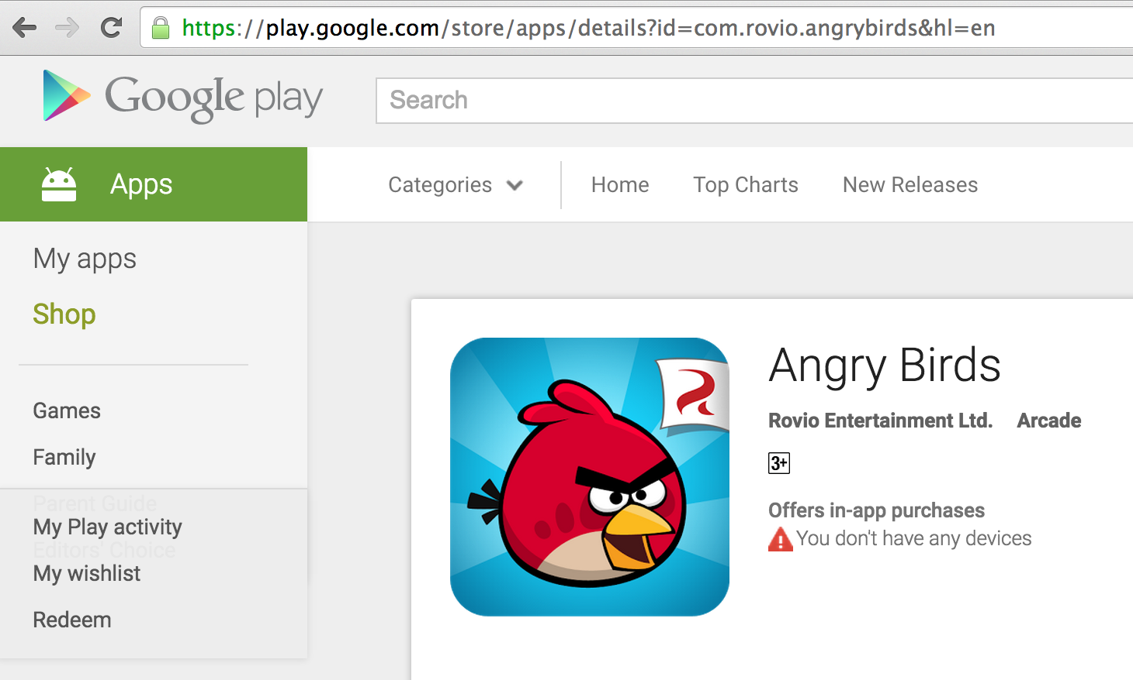
Identifiers, You Say …
Marketplace Identifiers
Google Play | com.rovio.angrybirds
Apple iTunes | 409807569
Nokia OVI store | 23158

Slide 11
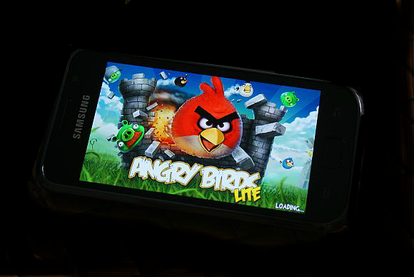
An HTTP GET Request on Android …
HTTP Header
200 OK
…
Client: 192.168.1.10 Scheme:http
GET
User-Agent: Mozilla/4.0 (Linux; U; Android
4.3; …)
Connection: Keep-Alive
.
? … &msid=com.rovio.angrybirds& …
The market place identifier!

Slide 12
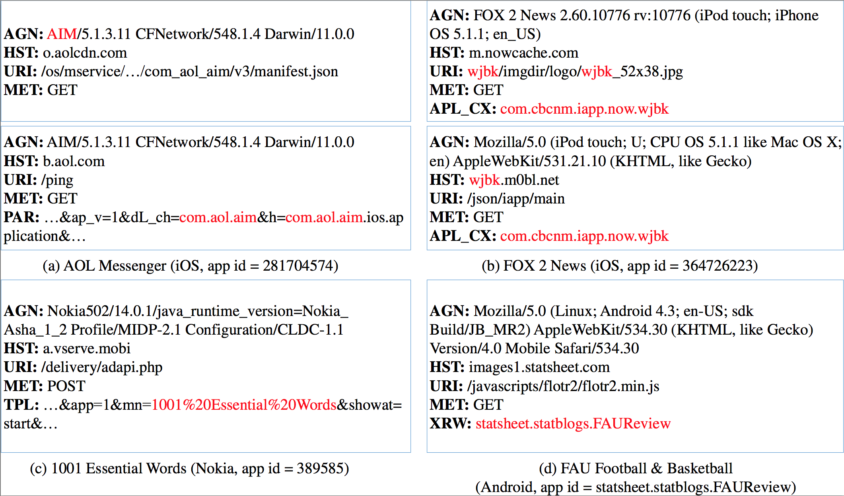
Identifiers and Lexical Snippets
Identifiers in HTTP Headers
Of various types
In different fields
For multiple applications
On all platforms
Lexical Snippet
A delimited sub-string in the HTTP header
(or payload) that contains in it an application
identifier.

Slide 13
Putting Things in Context …
For each observed lexical snippet, we ask:
  Which identifier type is it?
  Where in the header/payload does it occur?
  What prefix/suffix surrounds its occurrence?
A conjunctive rule
  Generalized lexical context that persists across multiple applications.
  And the conditions under which it is valid.

Slide 14
From Context to Conjunctive Rules
App Id | Identifier Type | Field Name: Snippet
281704574 | cfbundlename/displayname | AGN: AIM/5.1.3.11 CFNetwork/548.1.4 Darwin/11.0.0
281935788 | cfbundlename/executable | AGN: Essentials/1309241730 CFNetwork/609.1.4 …
282935706 | cfbundlename/displayname/executable | AGN: Bible/4.0.1 CFNetwork/548.0.4 Darwin/11.0.0
Lexical Context: |  | AGN: ˆ(.+)/[0-9].+ CFNetwork/[0-9].+ Darwin/[0-9].+
App-Ident-Rule:
Extract FROM AGN, Pattern:^(.+)/[0-9].+ CFNetwork/[0-9].+ Darwin/[0-9].+,
AND Lookup IN {cfbundleexecutable / cfbundlename / cfbundledisplayname}.

Slide 15
From Context to Conjunctive Rules
App Id | Identifier Type | Field Name: Snippet
286851614 | App Id | PAR: ... &msid=286851614& ...
288553125 | App Id | PAR: ... &msid=288553125& ...
291826753 | App Id | PAR: ... &msid=291826753& ...
Lexical Context: |  | PAR: \b msid=(\d{9}) \b
App-Ident-Rule:
Extract FROM PAR, Pattern:\b (\d{9}) \b, AND Lookup IN {appid} IF HST: googleads.g.doubleclick.net.

Slide 16
1 | Motivation & Background
2 | Identifiers, Lexical Snippets & Conjunctive Rules
3 | Methodology
4 | Evaluation

Slide 17
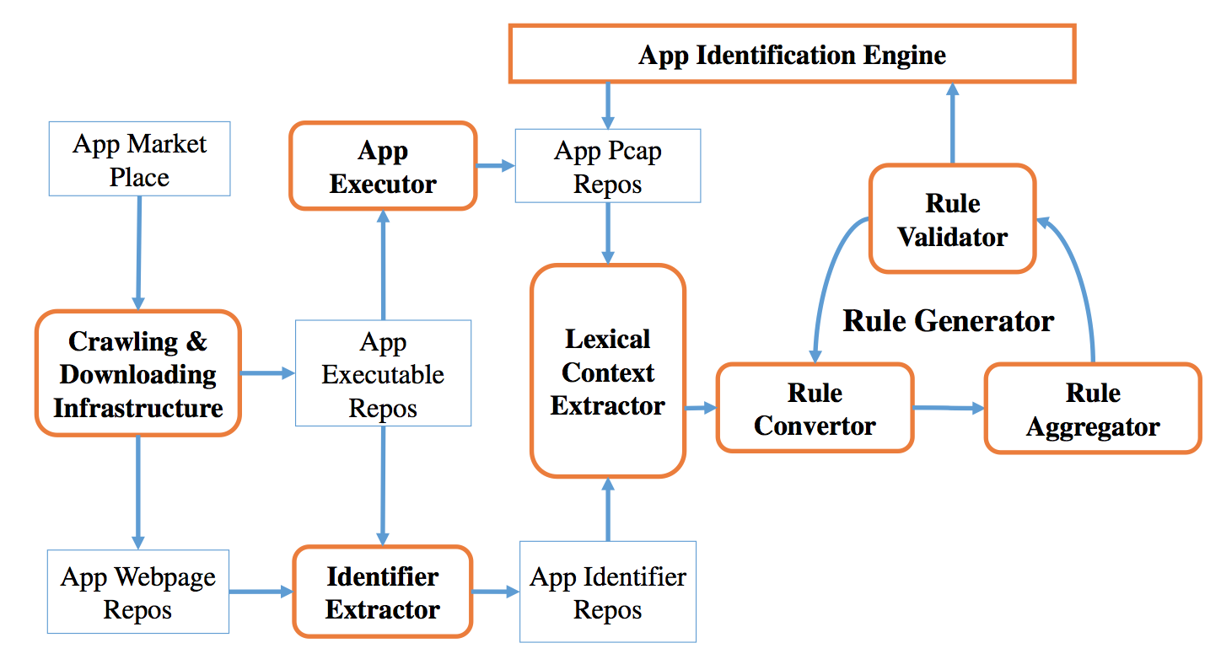
The SAMPLES WAR-MACHINE
For a given app marketplace:
Crawl and download applications
Application webpage
Application executable (Free apps)
Operational result:
Application repository: web-pages and
app-executables.

Slide 18
The SAMPLES WAR-MACHINE
For an app in the repository:
Extract identifiers from
Application webpage
Application executable (Free apps)
Operational result:
Set of application identifiers grouped by type.

Slide 19
The SAMPLES WAR-MACHINE
For an app in the repository:
Execute the application in an emulator to
Produce HTTP flows for the app
Store flows in labeled pcap files.
Operational result:
Labeled application flow headers.

Slide 20
The SAMPLES WAR-MACHINE
For a pcap in the training set:
Identify lexical snippets in flows by
Looking for occurrence of identifiers
Extracting the general lexical context
Operational result:
Labeled lexical context training set.

Slide 21
The SAMPLES WAR-MACHINE
For each lexical context:
Create conjunctive rules through
Aggregating general contexts
Validating over test data
Operational result:
Conjunctive Rules.

Slide 22
1 | Motivation & Background
2 | Identifiers, Lexical Snippets & Conjunctive Rules
3 | Methodology
4 | Evaluation

Slide 23
Summary of Results
Platform | # Applications | # Flows | # Training Applications | # Rules Produced | Application Coverage*
Android | 651, 000 | 13,000,000 | 22,000 | 51 | 96%
iOS | 68,000 | 478,000 | 32,000 | 64 | 92%
Nokia/Symbian | 10,000 | 39,000 | 5,000 | 12 | 99%
* Of the 76.8%, 67.4% and 63.2% (respectively) of applications that generate at least one flow header with an identifier in them.
Notes:
Google Play store, iTunes store, and Nokia OVI store and collected 651K Android apps, 68K iOS apps, and 10K Nokia apps, respectively. By executing each downloaded app in software emulators, we captured 13, 003K Android flows, 478K iOS flows and 39K Nokia flows. We use flows from 22K Android apps, 32K iOS apps, and 5K Nokia apps as the training set and the rest as the testing set.
Over 99% of the flows’ originating apps can be correctly identified. Furthermore, the rule set also covers most of identifiable apps in the network. We can identify 74%, 62% and 63% apps on Android, iOS and Nokia test set, respectively. As a comparison, there are only 76.8%, 67.4% and 63.2% apps among those three datasets that is identifiable, respectively. In an- other word, SAMPLES can identify over 90% of identifiable apps among three platforms.

Slide 24
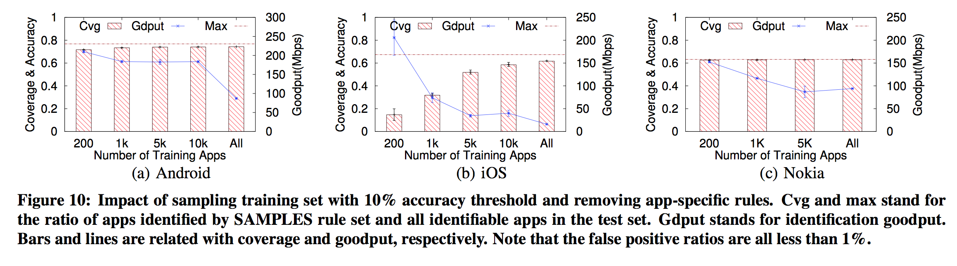
Robustness to Sampling Bias
Notes:
Google Play store, iTunes store, and Nokia OVI store and collected 651K Android apps, 68K iOS apps, and 10K Nokia apps, respectively. By executing each downloaded app in software emulators, we captured 13, 003K Android flows, 478K iOS flows and 39K Nokia flows. We use flows from 22K Android apps, 32K iOS apps, and 5K Nokia apps as the training set and the rest as the testing set.
Over 99% of the flows’ originating apps can be correctly identified. Furthermore, the rule set also covers most of identifiable apps in the network. We can identify 74%, 62% and 63% apps on Android, iOS and Nokia test set, respectively. As a comparison, there are only 76.8%, 67.4% and 63.2% apps among those three datasets that is identifiable, respectively. In an- other word, SAMPLES can identify over 90% of identifiable apps among three platforms.

Slide 25
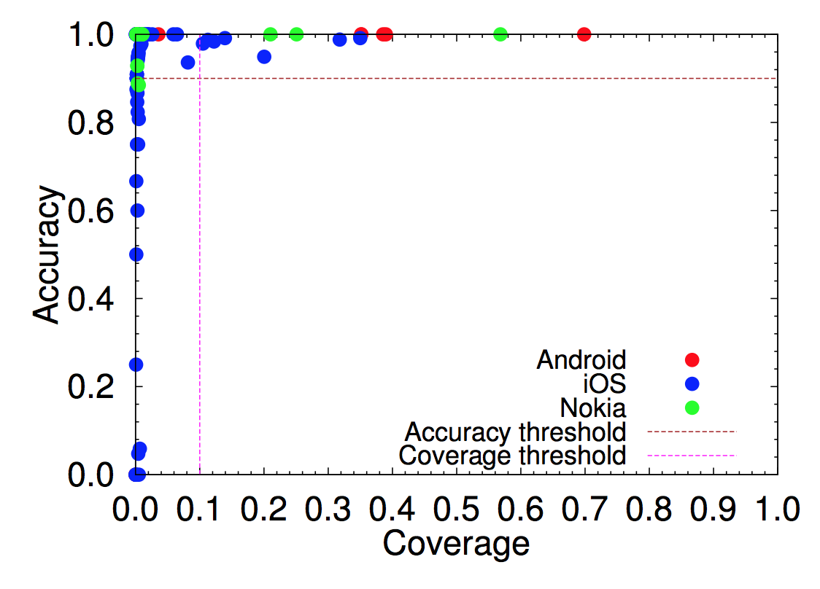
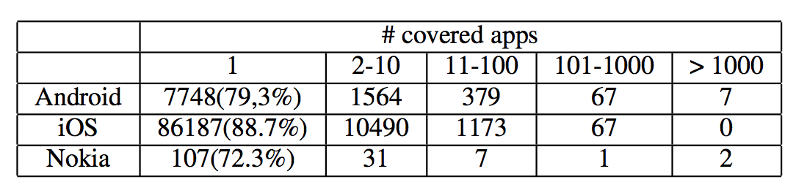
The Leader Effect
A small subset of rules account for a large fraction of applications with high accuracy for all platforms.

Slide 27
Gyan Ranjan
Gyan_Ranjan@Symantec.com

Slide 28
Backup Slides
Subtitle here

Slide 29
HTTPS with Woman-In-The-Middle
200 OK
Content-Type: application/json;charset=utf-8
Content-Length: 139
X-Max-Sequence: 1
{ "@pendingMsg" : 0, "@syncStatus": 0, "responses" : [ { "disconnect" : { "sequence" : 1, "receiver" : “a*******”, "reason" : 4 } }
] }
Client: 192.168.1.10 Scheme: https
GET 216.115.100.103:443/pe/4d8c5d92/92bcb62d/3661ec2a/15957/config/prod/config.xml
Cache-Control: no-cache, no-transform
Accept-Encoding: gzip
Accept: */*
User-Agent: YahooMobileMessenger/1.0 (Android Messenger; 1.8.4) (grouper; asus; Nexus 7; 4.2.2/JDQ39B)
Host: s.yimg.com
Connection: Keep-Alive
Client: 192.168.1.11 Scheme: https
POST 31.13.75.1:443/login.php?login_attempt=1
Host: www.facebook.com
User-Agent: Mozilla/5.0 (X11; Ubuntu; Linux x86_64; rv:26.0) Gecko/20100101 Firefox/26.0
Accept: text/html,application/xhtml+xml,application/xml;q=0.9,*/*;q=0.8
Accept-Language: en-US,en;q=0.5
Accept-Encoding: gzip, deflate
Referer: https://www.facebook.com/
Cookie: datr=bJLQUo4rXIgvkkOEKRA6ikD7; reg_fb_gate=https%3A%2F%2Fwww.facebook.com%2F; reg_fb_ref=https%3A%2F%2Fwww.facebook.com%2F; wd=1440x692; act=1389400695566%2F0; …
Connection: keep-alive
Content-Type: application/x-www-form-urlencoded
Content-Length: 144
lsd=AVqqYCGq&email=a*******@mail.com&pass=testPass%402013&….

Slide 30
Crawl
App Market Place
App Identification Engine
1. Sample web- pages
4. Download app executable archive
Crawler
Downloader
Executor
5. Store app executable archive
6. Get app executable archive
2. Store web-pages
3. Get App- Content id
7. Store pcap
App Web Page Repos
App Executable Repos
App Pcap Repos

Slide 31
Download
App Market Place
App Identification Engine
1. Sample web- pages
4. Download app executable archive
Crawler
Downloader
Executor
5. Store app executable archive
6. Get app executable archive
2. Store web-pages
3. Get App- Content id
7. Store pcap
App Web Page Repos
App Executable Repos
App Pcap Repos

Slide 32
Example Rules
<MOBSIG>
<PLATFORM>Nokia</PLATFORM>
<SIGID>N1</SIGID>
<SIG_PRIORITY>HIGH</SIG_PRIORITY>
<LOOKUP_DB_METADATA_NOKIA>Nokia_mn_maps</LOOKUP_DB_METADATA_NOKIA>
<MATCH>
<MET>GET|POST|HEAD</MET>
</MATCH>
<NOTMATCH>
</NOTMATCH>
<EXTRACTION>
<TPL>\bmn=(.*?)&</TPL>
<EPL>\bmn=(.*?)&</EPL>
<PAR>\bmn=(.*?)&</PAR>
</EXTRACTION>
</MOBSIG>
<MOBSIG>
<PLATFORM>Android</PLATFORM>
<SIGID>GAD4</SIGID>
<SIG_PRIORITY>HIGH</SIG_PRIORITY>
<LOOKUP_DB_METADATA_ANDROID>googleAds_Key_MSID</LOOKUP_DB_METADATA_ANDROID>
<MATCH>
<MET>GET</MET>
<HST>googleads\.g\.doubleclick\.net</HST>
</MATCH>
<NOTMATCH>
</NOTMATCH>
<EXTRACTION>
<PAR>\bmsid=(.*?)&</PAR>
</EXTRACTION>
</MOBSIG>

Slide 33
App Identification: The Three Step Process
Nokia_mn_maps
<MOBSIG>
<PLATFORM>Nokia</PLATFORM>
<SIGID>N1</SIGID>
<SIG_PRIORITY>HIGH</SIG_PRIORITY>
<LOOKUP_DB_METADATA_NOKIA>Nokia_mn_maps</LOOKUP_DB_METADATA_NOKIA>
<MATCH>
<MET>GET|POST|HEAD</MET>
</MATCH>
<NOTMATCH>
</NOTMATCH>
<EXTRACTION>
<TPL>\bmn=(.*?)&</TPL>
<EPL>\bmn=(.*?)&</EPL>
<PAR>\bmn=(.*?)&</PAR>
</EXTRACTION>
</MOBSIG>
Rule: N1
Extract:\bmn=(.*?)&
Lookup Metadata File
Extracted String|appId
1001%20Essential%20Words|389585
100%20Good%20Wishes%20For%20Baby|301760
…
1916%20Dogfight|361323
1916+Dogfight|361323
…
Validate application
mobilityIds2Metadata.txt
# | appId | app Name | category | platform
3100646|389585|1001 Essential Words|Entertainment| |nokia
3048586|301760|100 Good Wishes for Baby|Utilities| |nokia
…
3083940|361323|1916 Dogfight|Action| |nokia
…

Slide 34
App Identification: Example
Nokia_mn_maps
<NarusVector>
<HST>a.vserv.mobi</HST>
<SIP>10.0.2.15</SIP>
<MET>POST</MET>
<TS>4061433202</TS>
<DIP>54.214.39.142</DIP>
<TPL>ua=Nokia502%2F14.0.1%2Fjava_runtime_version=Nokia_Asha_1_2%20Profile%2FMIDP%2D2.1%20Configuration%2FCLDC%2D1.1&sw=240&sh=302&vr=j0.1.15&app=1&mn=1916%20Dogfight&vs3=1&sg=1&ts=1&ps=1&lc=en&im=18997660069511359566&smsc=123456&pd=30%2F6%2F2014&pt=11%3A44%3A31&av=1.0.0&showat=start&zoneid=18997</TPL>
…
</NarusVector>
Rule: N1
Extract: 1916%20Dogfight
Lookup Metadata File
Extracted String|appId
1001%20Essential%20Words|389585
100%20Good%20Wishes%20For%20Baby|301760
…
1916%20Dogfight|361323
1916+Dogfight|361323
…
Validate application
mobilityIds2Metadata.txt
# | appId | app Name | category | platform
3100646|389585|1001 Essential Words|Entertainment| |nokia
3048586|301760|100 Good Wishes for Baby|Utilities| |nokia
…
3083940|361323|1916 Dogfight|Action| |nokia
…

